Slide 1
Analyze of multimodality of gene expression profiles using publicly available databases
Amir Vajdi

Slide 2
Outline
Kallisto Method
Running Kallisto
TCGA and GTEx database
Multimodality Analysis

Slide 3
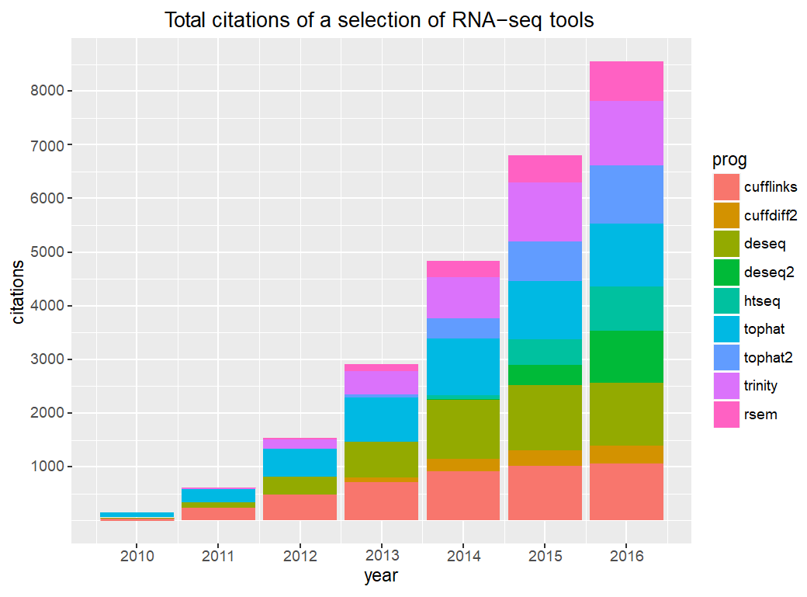
The growth of RNA-seq
https://pachterlab.github.io/kallisto-sleuth-workshop-2016/

Slide 4
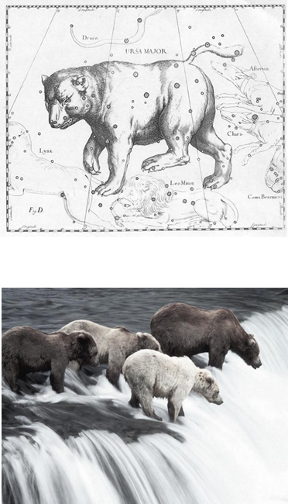
kallisto-sleuth project
k-mers alone lose lots of information; strong together only
kallisto quantification
Sleuth analysis
Bray, N. L., Pimentel, H., Melsted, P., & Pachter, L. (2016). Near-optimal probabilistic RNA-seq quantification. Nature biotechnology, 34(5), 525.

Slide 5
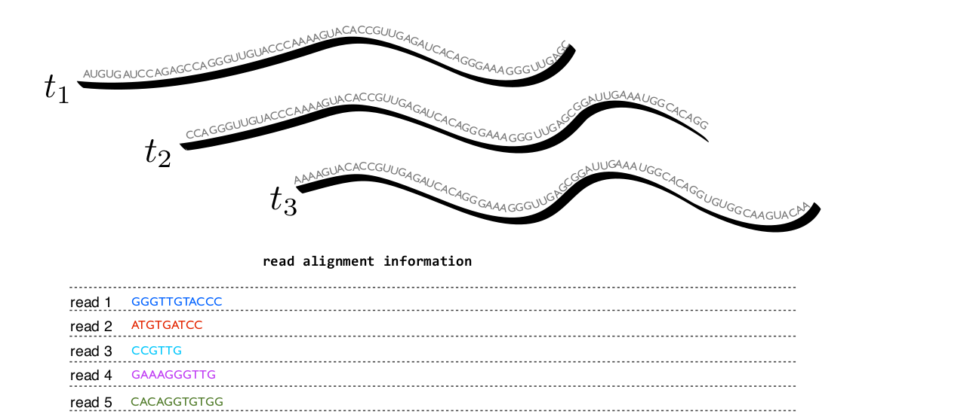
Alignment based analysis
https://pachterlab.github.io/kallisto-sleuth-workshop-2016/

Slide 6
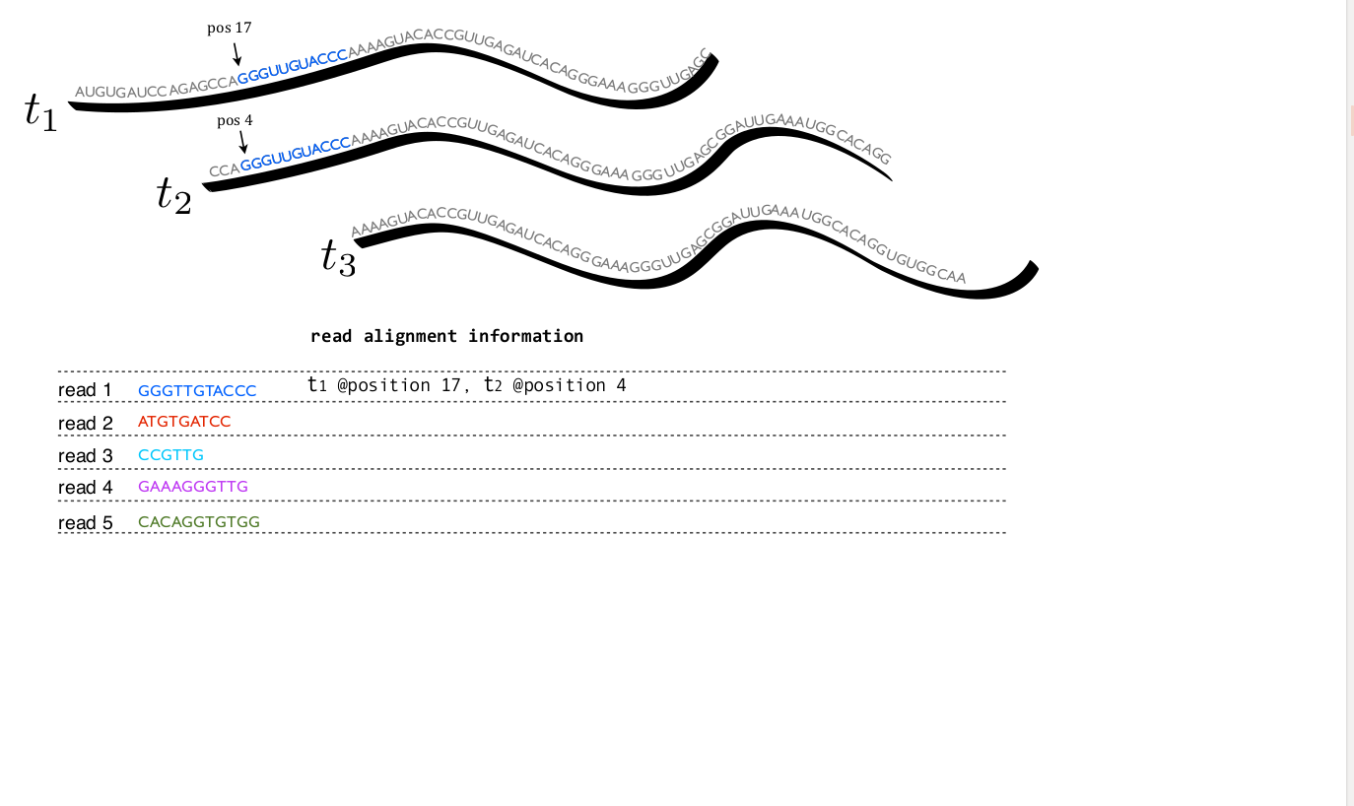
Alignment based analysis
https://pachterlab.github.io/kallisto-sleuth-workshop-2016/

Slide 7
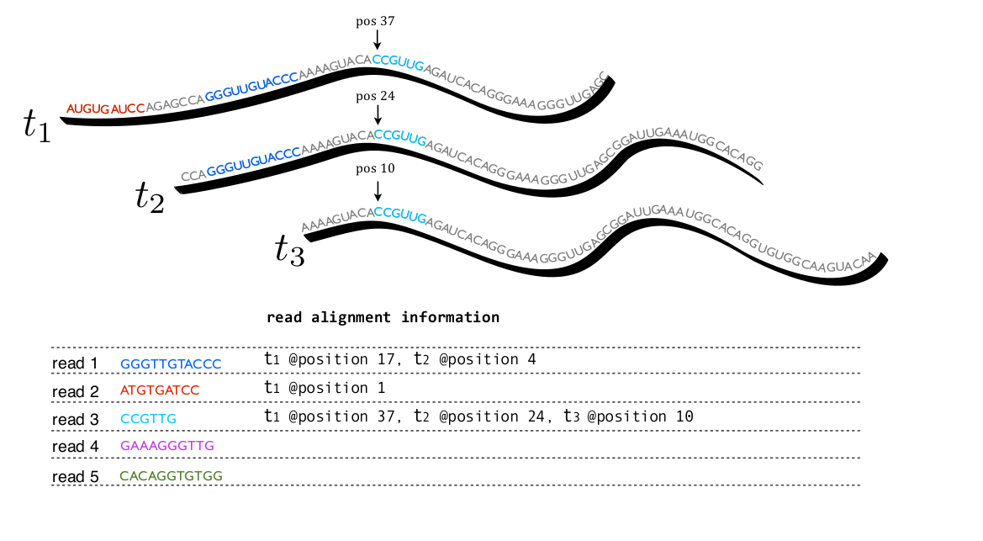
Alignment based analysis
https://pachterlab.github.io/kallisto-sleuth-workshop-2016/

Slide 8
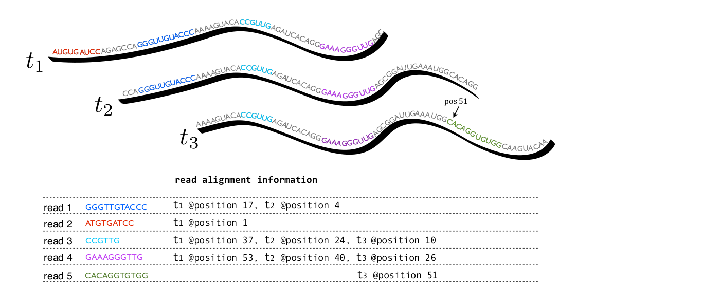
Alignment based analysis
Even ultra-fast alignment is still pretty slow
Alignments contain information that we don’t usually care about

Slide 9
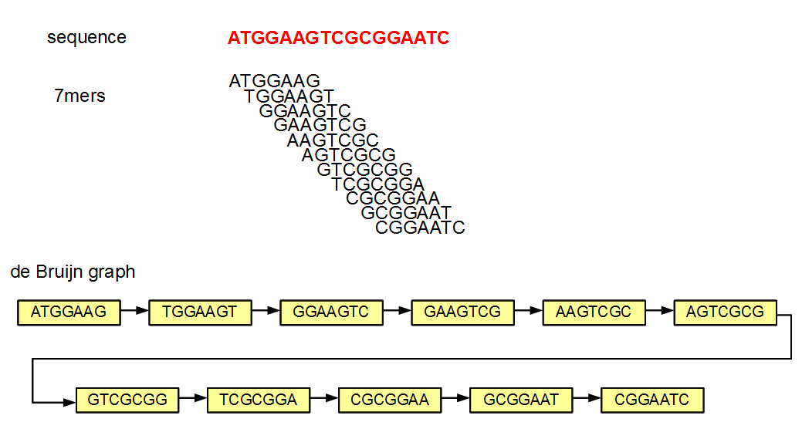
De Bruijn Graph
an n-dimensional De Bruijn graph of m symbols is a directed graph representing overlaps between sequences of symbols. It has m^{n} vertices, consisting of all possible length-n sequences of the given symbols.

Slide 10
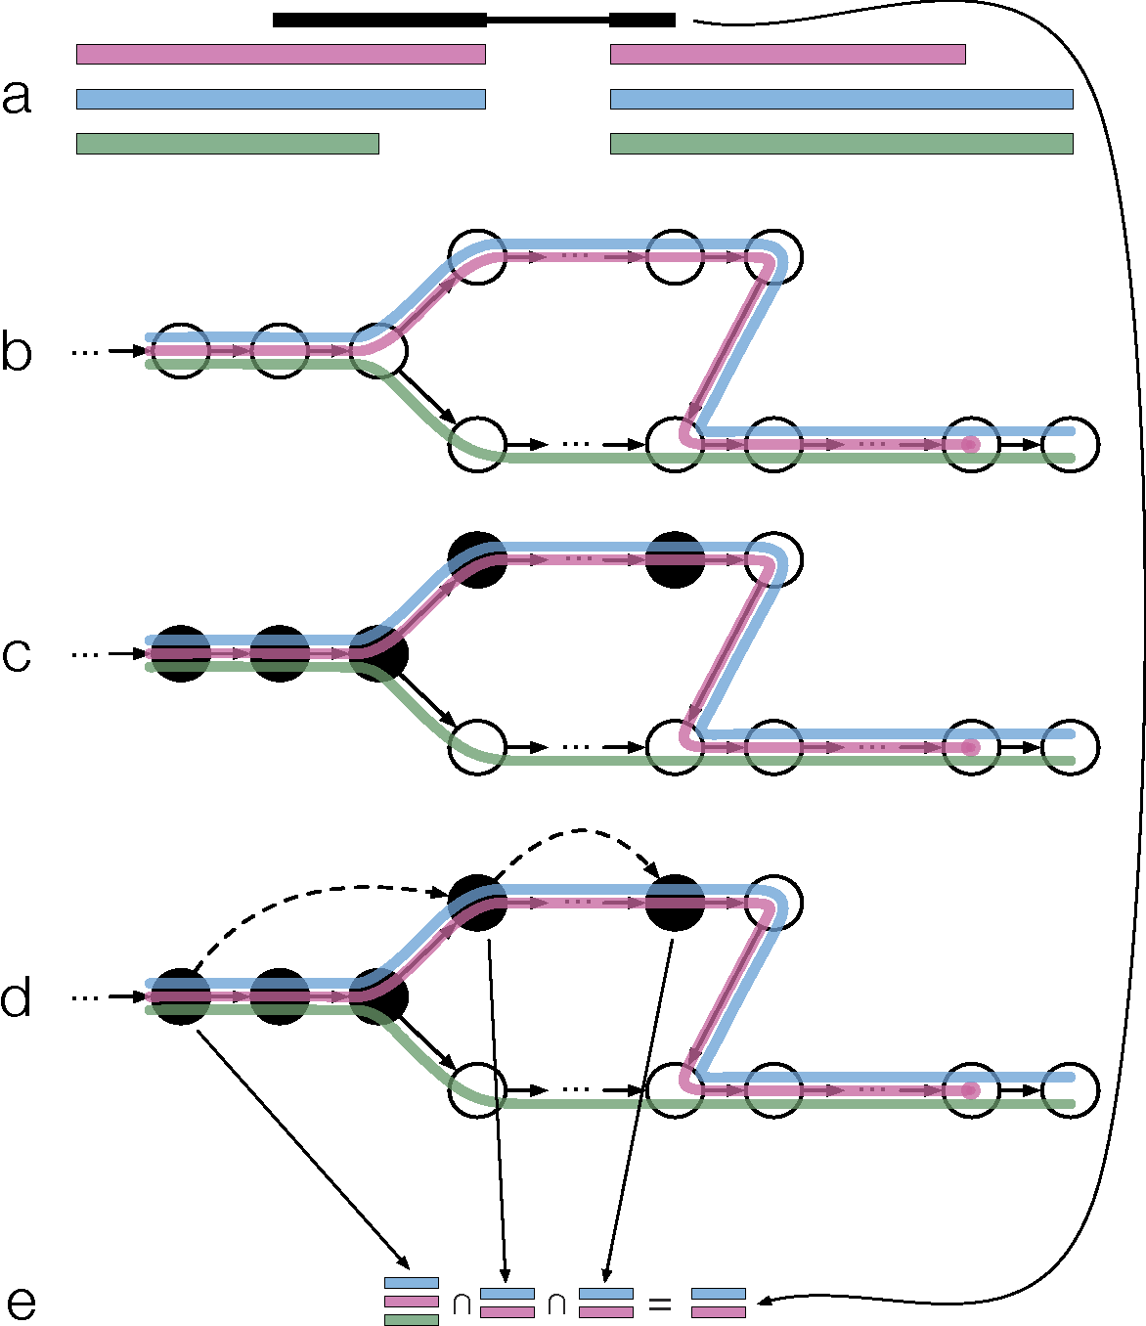
Kallisto Terms
A pseudo-alignment of a read to a set of
transcripts, T, is a subset, S ⊆ T without specific
coordinates mapping each base in the read to
specific positions in each of the transcripts in S.
A path covering of the graph: a set of paths
whose union covers all edges of the graph, where
the paths correspond to transcripts.

Slide 11
Kallisto Terms
This path covering of a T-DBG induces multi-sets
on the vertices, called k-compatibility classes
Each read is compatible with one or more
Transcripts
An equivalence class is a group of reads that
are compatible with the same set of transcripts
A key point is that the k-compatibility class of an error-free read coincides with the
minimal equivalence class consisting of transcripts containing the read for large k.

Slide 12
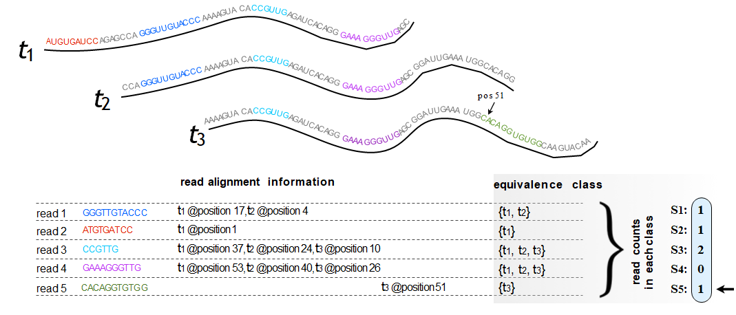
Kallisto Idea
Identifying the transcripts from which the read could have originated
idea: let’s compute that directly rather than a basepair-level alignment that has more information than we need

Slide 13
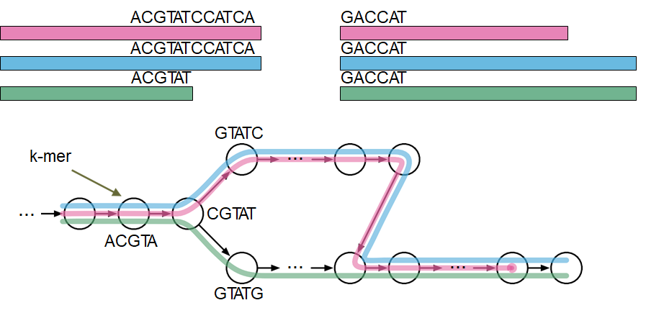
How kallisto computes pseudoaligments
Given our reference transcriptome,
we first construct its target de Bruijn Graph (T-DBG)
Only has to be done once per transcriptome (and is fast)

Slide 14
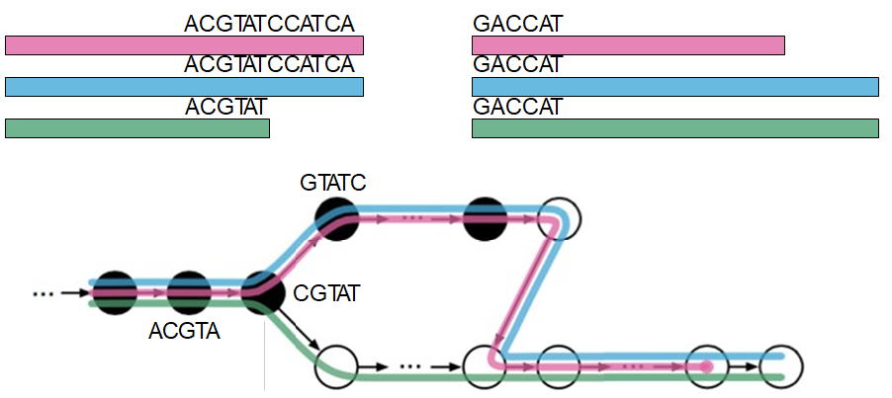
How kallisto computes pseudoaligments
Given a read, finding its k-mers in the T-DBG gives you information about where the read could have come from
This can be done very fast
But individual k-mers might be more ambiguous than the read as a whole

Slide 15
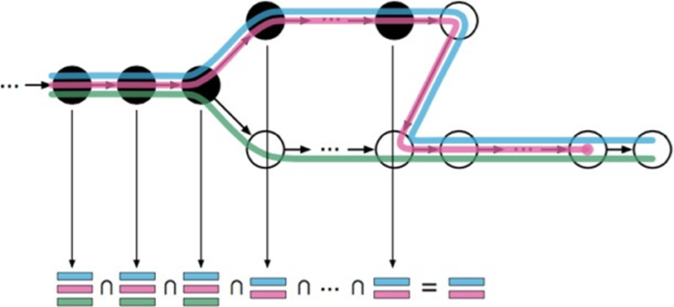
How kallisto computes pseudoaligments
Combining information across the k-mers can recover lost information
For each k-mer we have the set of transcripts it could have come from. Intersecting them gives the set of transcripts that all k-mers could have come from
It’s possible for their combination to have information equivalent to the entire read, even if no single k-mer does by itself

Slide 16
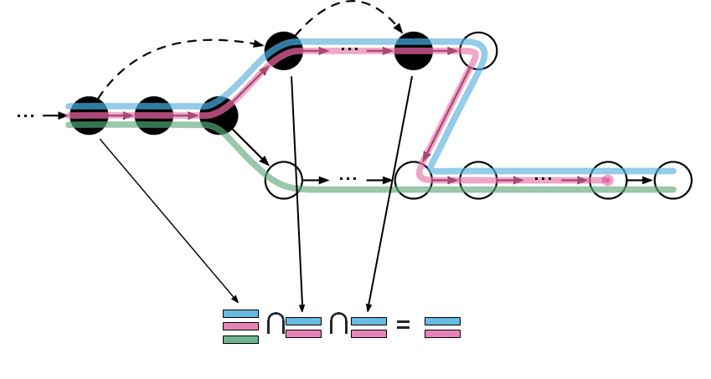
How kallisto computes pseudoaligments
Knowing the T-DBG, we can predict ahead of time which k-mers will be potentially interesting
By only processing those k-mers, kallisto runs ~8 times faster

Slide 17
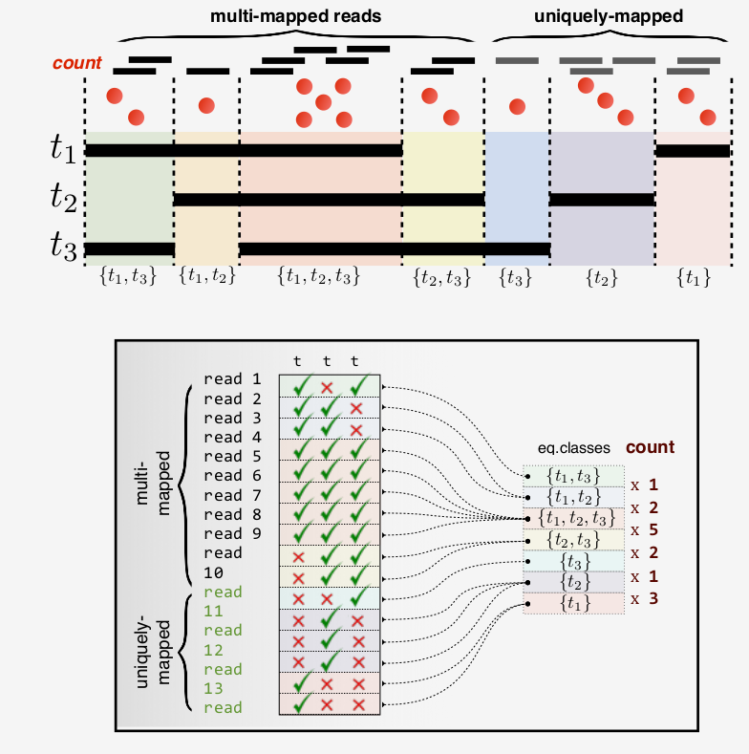
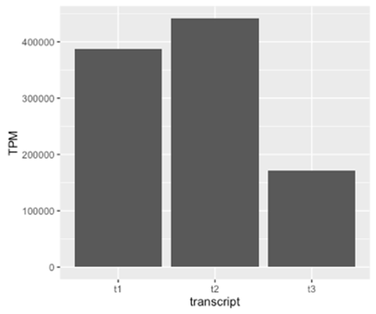

Transcript compatibility counts
X 2
X 1
X 5
X 2
X 1
X 3
X 2

Slide 18
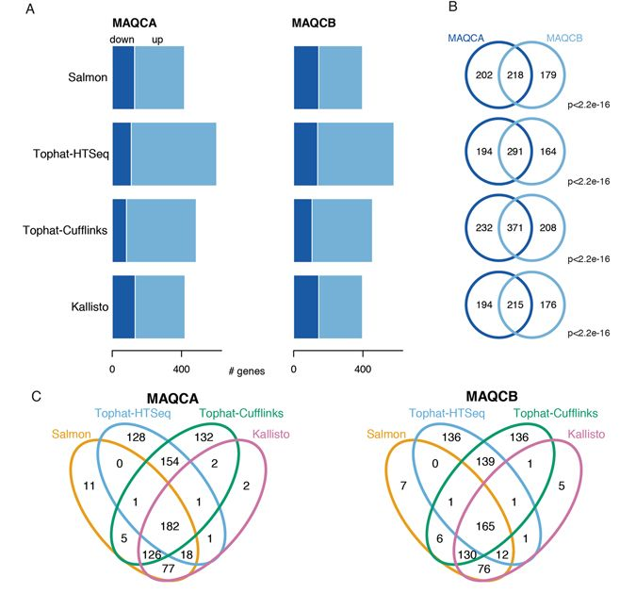
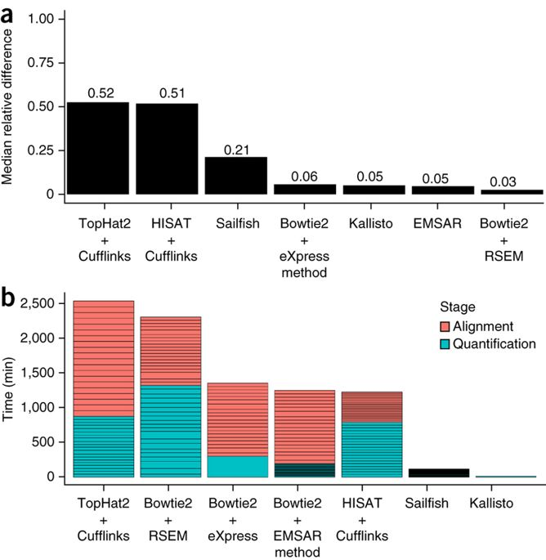
Benchmarking
Computation Cost:
TCGA pipeline $39/Sample
Kallisto $0.09/Sample
Benchmarking of RNA-sequencing analysis workflows using whole-transcriptome RT-qPCR expression data JO - Scientific Reports : 1559 (2017)

Slide 19
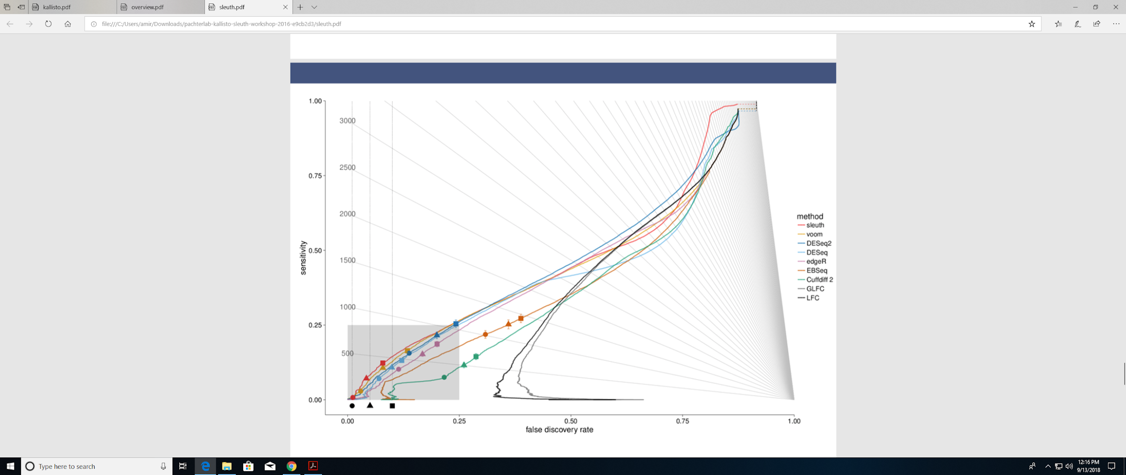
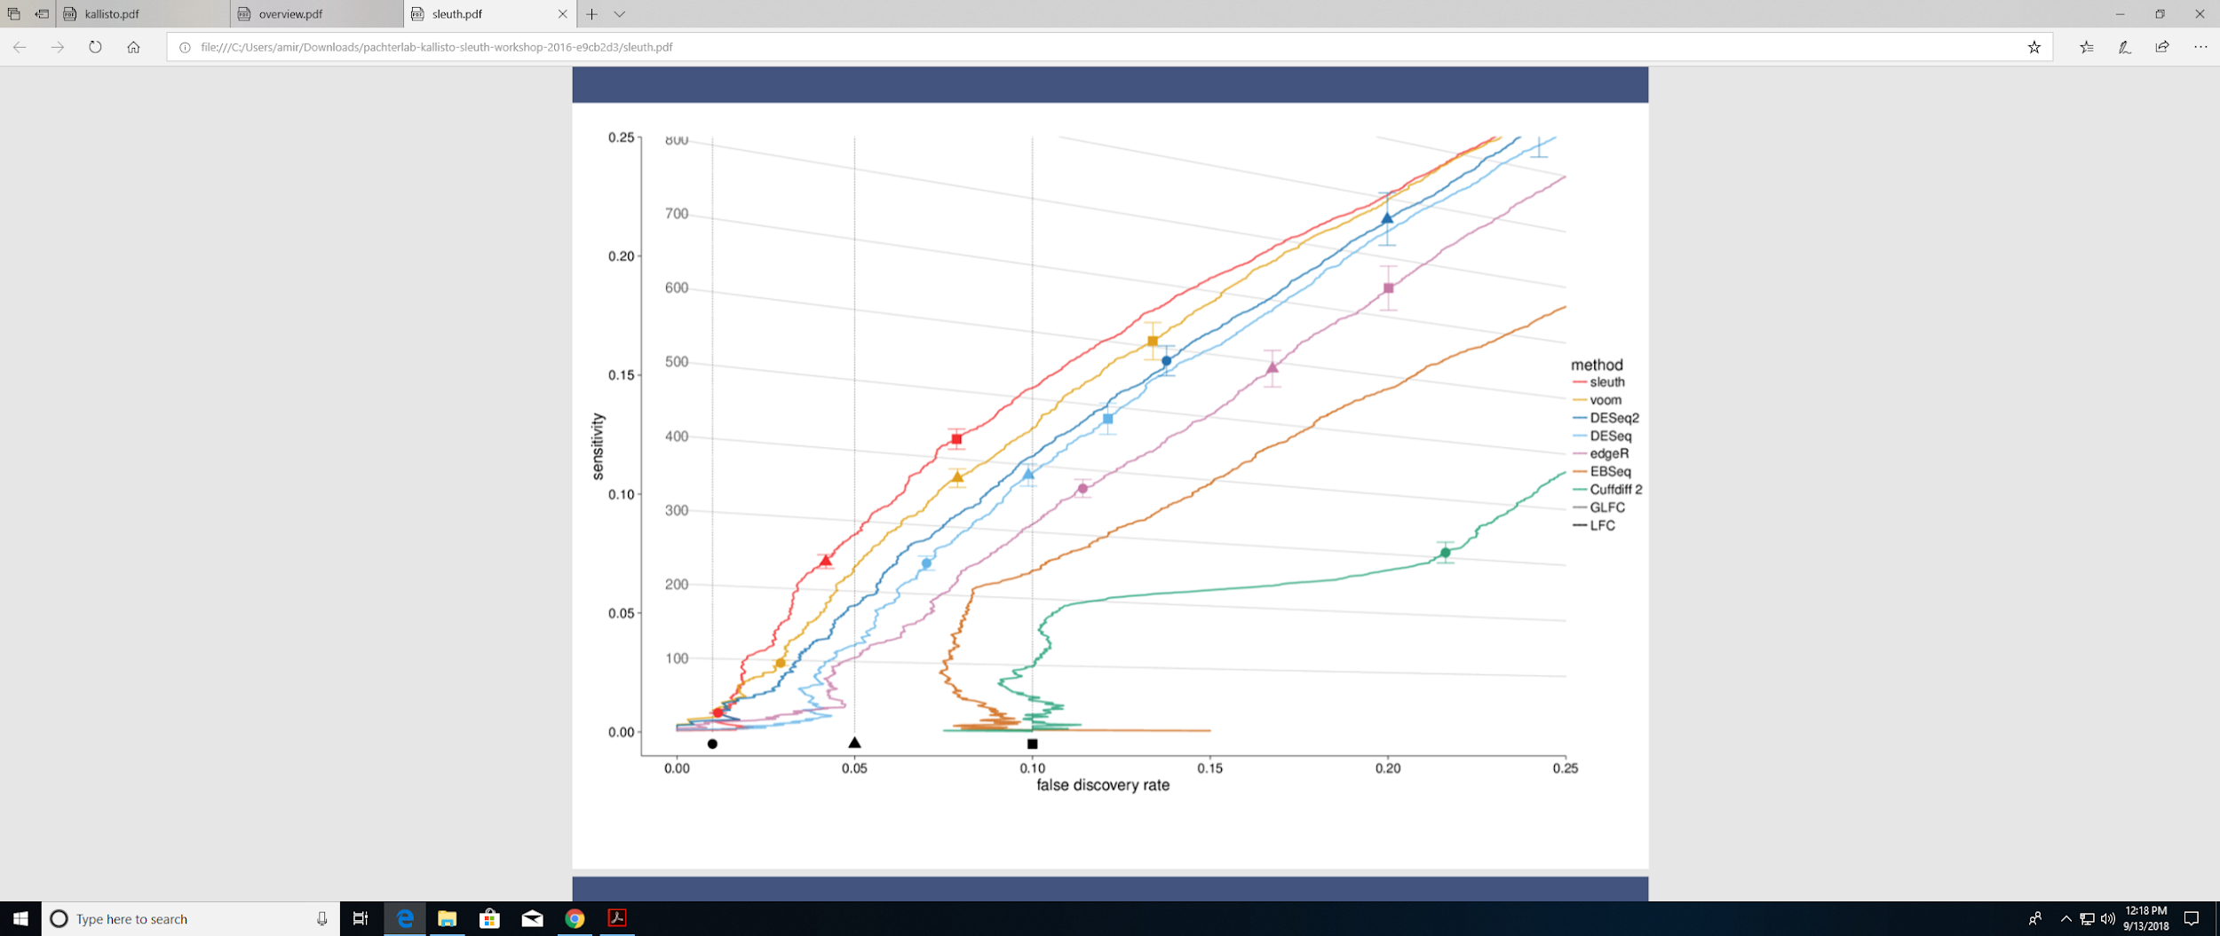
Benchmarking

Slide 20
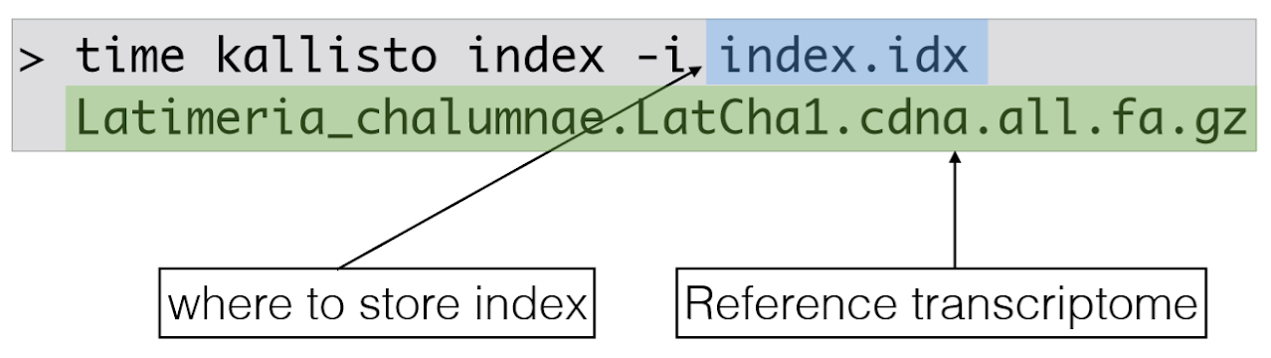
Running Kallisto
Requirements for running kallisto
Reference transcriptome
Paired end reads, FASTQ ﬁles
Creates an index of the transcriptome reference that kallisto will use for quantiﬁcation
k-mer tradeoffs
high k - more speciﬁc
low k - robust to sequencing errors
for 75bp reads, use default, k=31
for 50bp reads, use default except if known issues
shorter reads, lower k=25 or k=21.

Slide 21
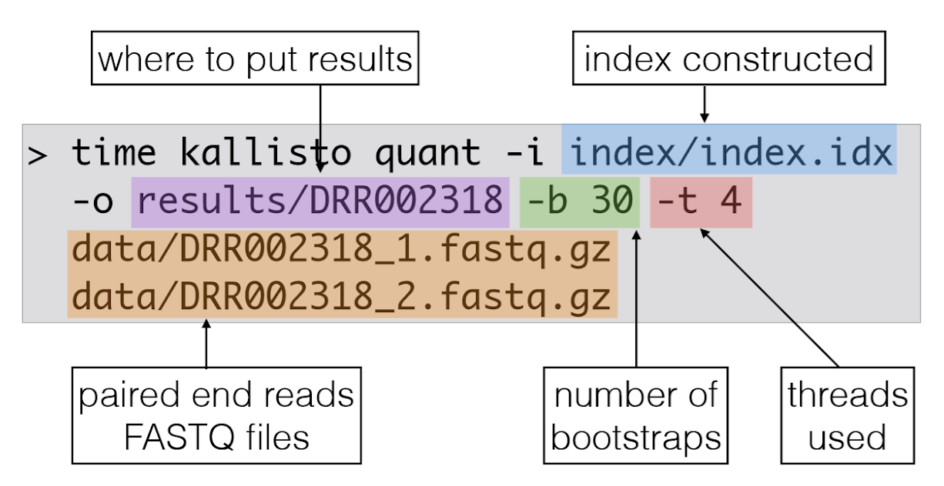
Quantiﬁcation

Slide 22
Result
The output is stored in the speciﬁed directory
abundance.h5 - HDF5 compressed ﬁle, not human readable contains the quantiﬁcations, all bootstraps and other information
abundance.tsv - Tab Separated ﬁle abundances and counts for each transcript
run_info.json - JSON formatted ﬁle information about the run

Slide 23

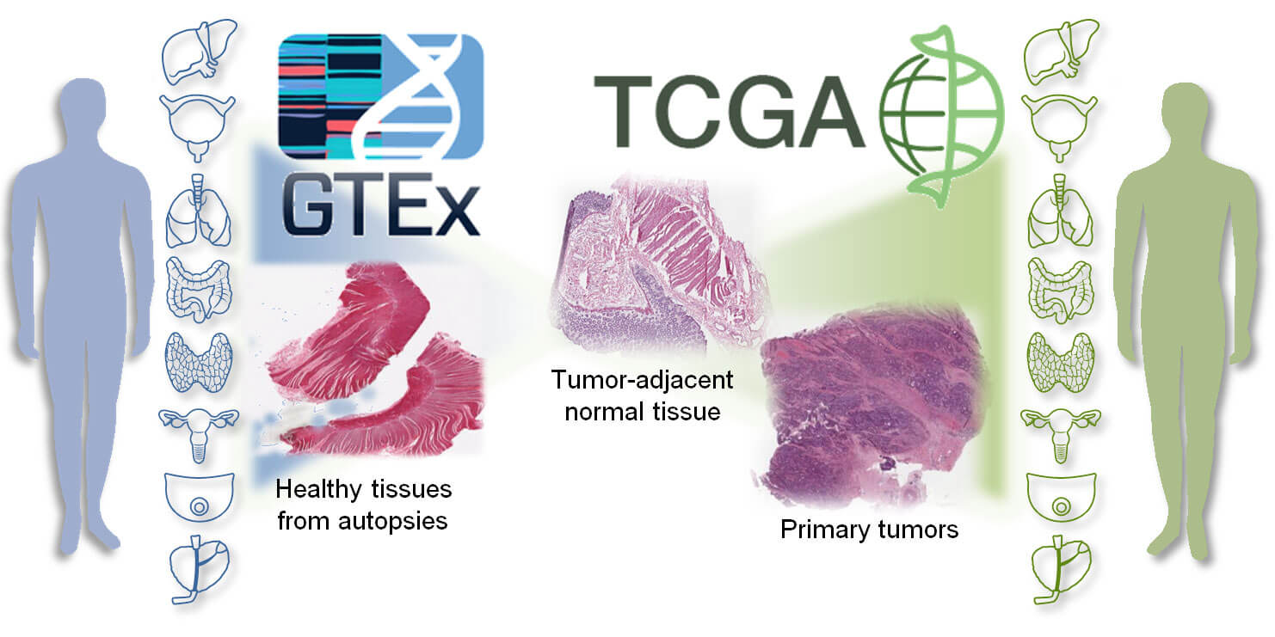
Analyzing Multimodality of gene expression data
Section 2

Slide 24
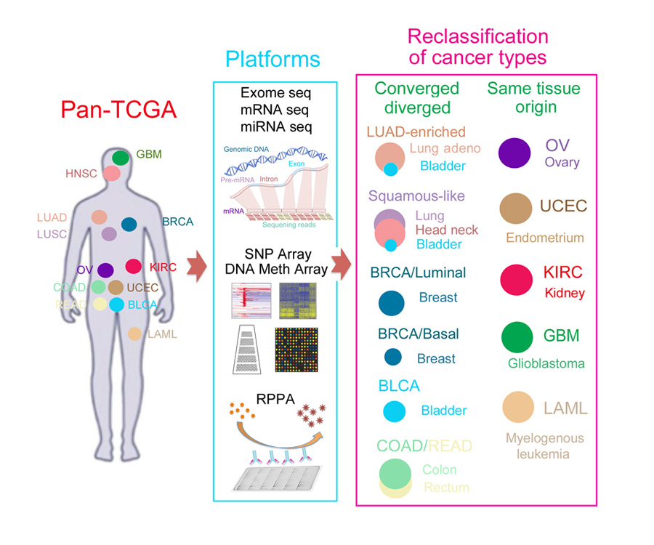
TCGA Database
Omics Characterizations
Mutations
Copy Number
DNA Methylation
Gene Expression
MicroRNA
RPPA
Clinical Data
Imaging

Slide 25
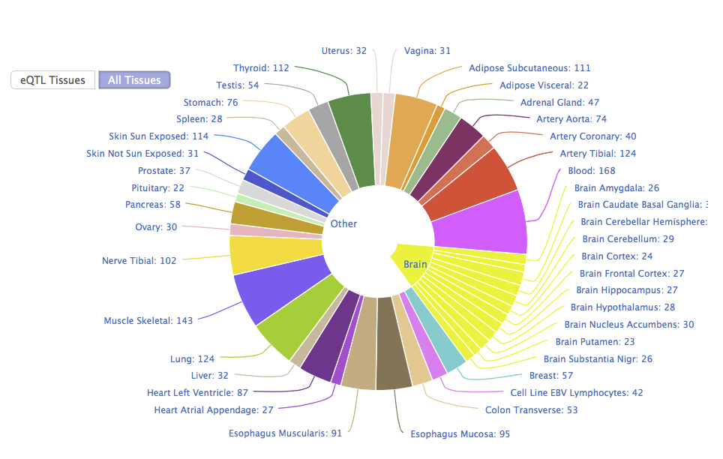
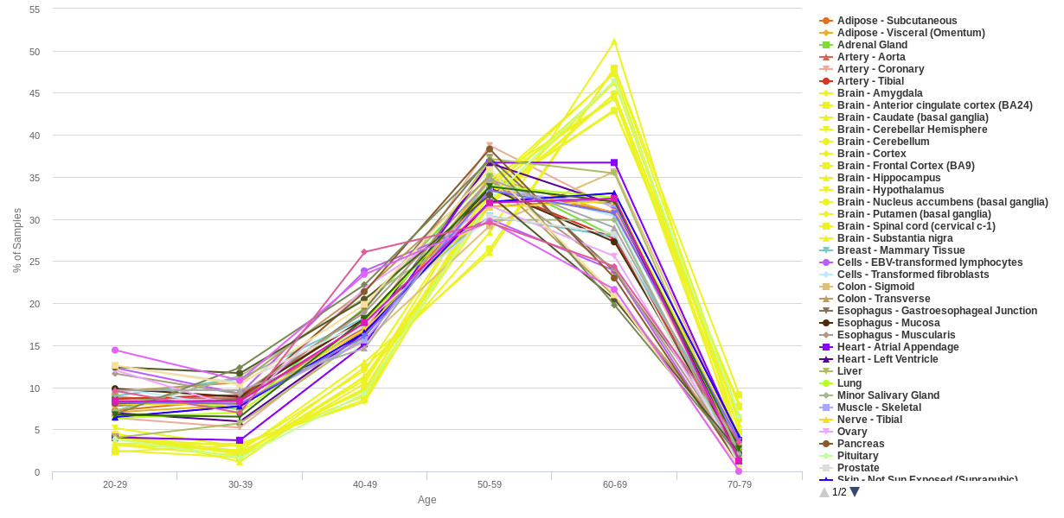
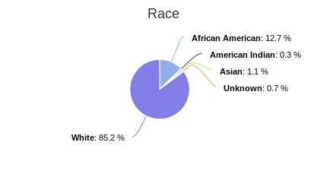
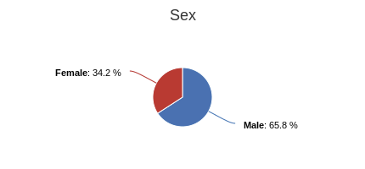
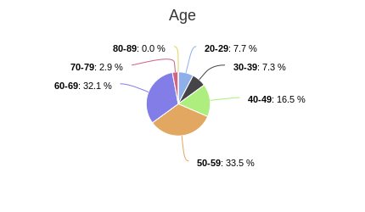
GTEx Database
11,688 Samples

Slide 26
Motivation
Understanding molecular and biological features that influence the expression of a gene
Distinguish genes with multimodal distributions
Explore over/under expressions calls of a subset of genes for some cancer types

Slide 27
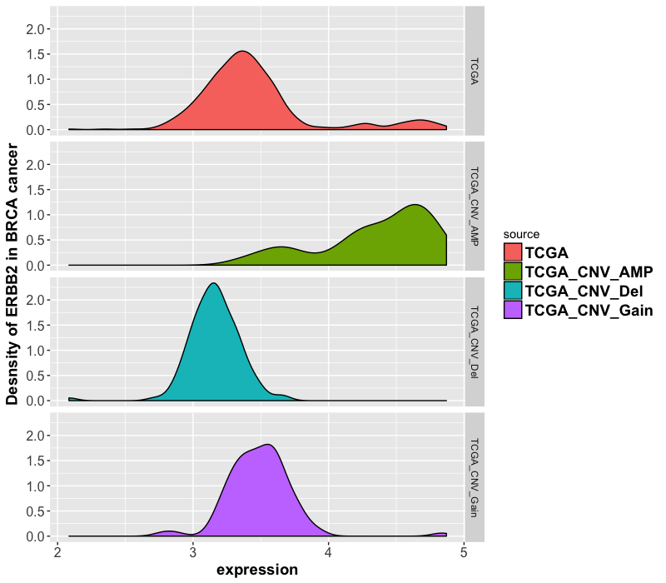
CNV
The expression of ERBB2 gene
in TCGA breast cancer has a direct
relation with copy number of
variation (CNV)

Slide 28
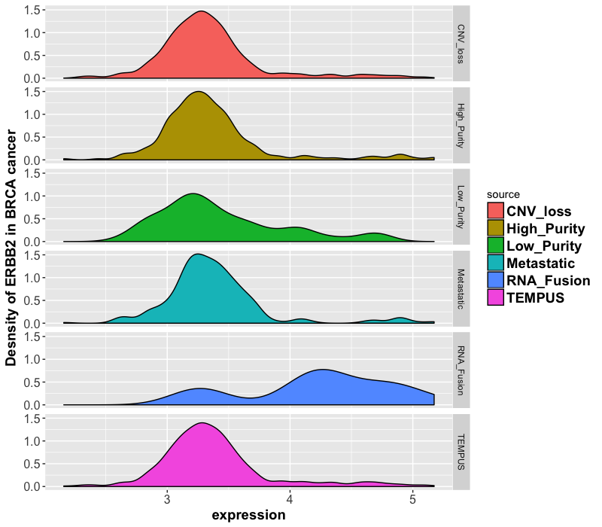
Fusion
Tempus samples with RNA
fusions involving ERBB2 have
higher expression of the gene
in breast cancer

Slide 29
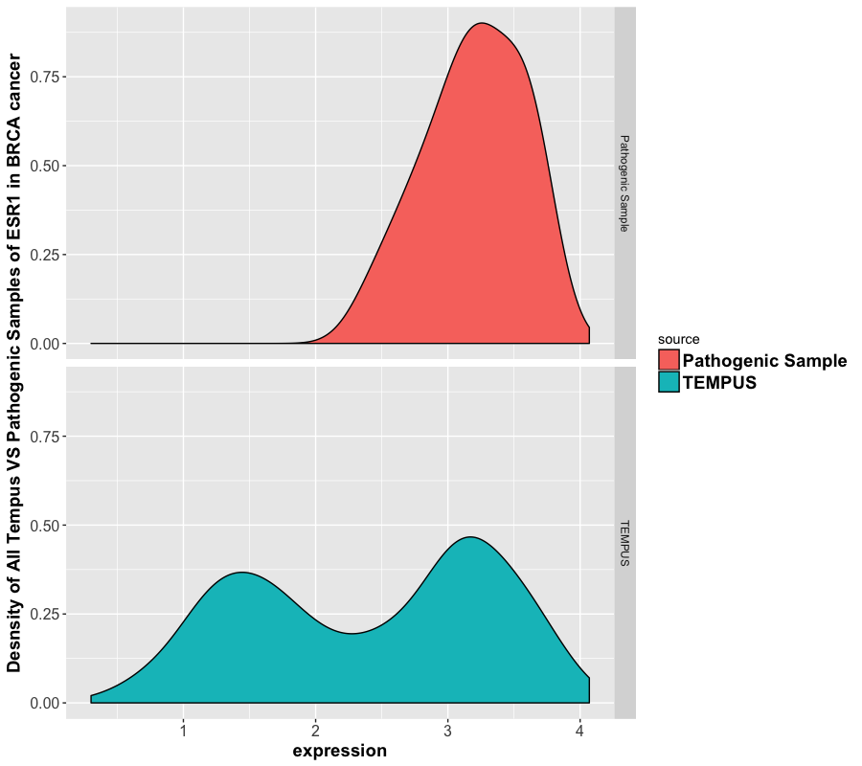
Pathogenic Variation
Tempus samples with Pathogenic
variants in breast cancer have
different expression patterns in ESR1 gene

Slide 30
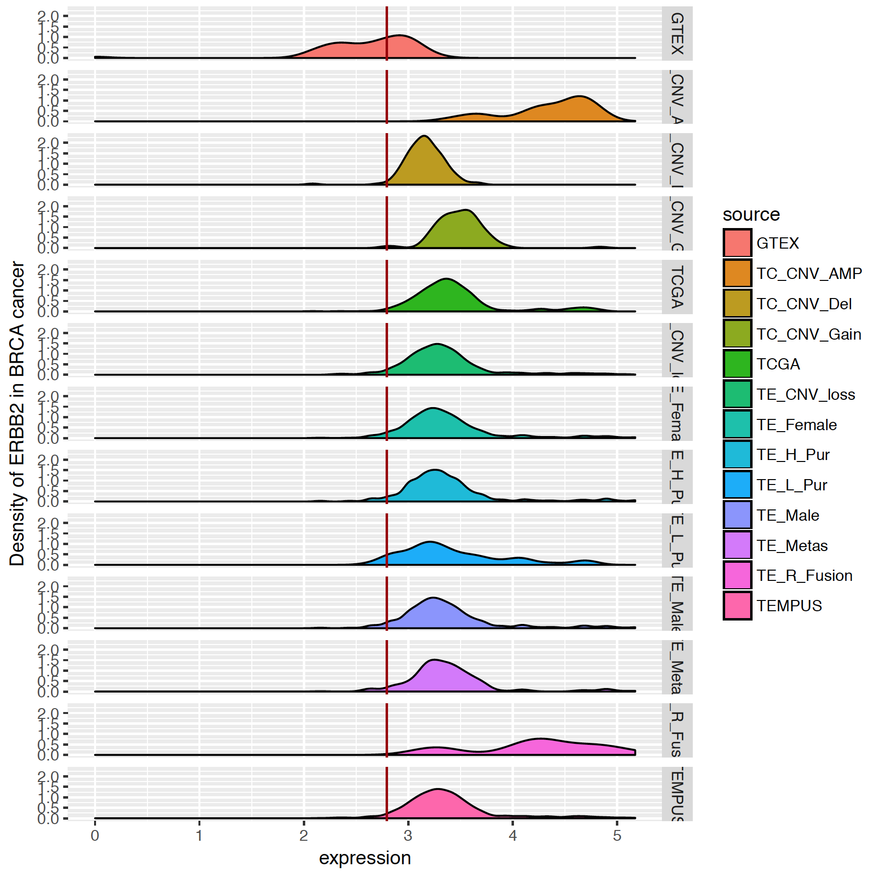
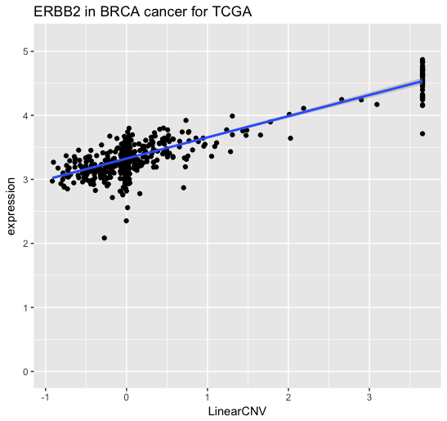
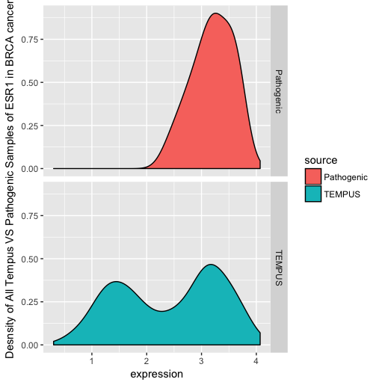
DNA Amplified samples
Pathogenic Samples

Slide 31
Challenges
Complexity of gene expression data
Samples Size
Noise Samples
Uncertainty of features
Non-linear relationship between gene expression and meta-data
Need a metric to distinguish between gene of interest

Slide 32
Data
13 Cancer Genes (Preliminary Analysis)
EGFR, MLH1, MGMT ,AR ,ERBB2 ,ESR1 ,PGR ,MAP3K1 ,MAP2K2 ,AKT1 ,AKT2 ,AKT3 ,MYC
32 Cancer Types
25,469 Expression Samples (TCGA, GTEx, Tempus)
Meta data
Biological: Race, Gender, Age, Vital Status
Molecular: CNV, Tumor Purity, Metastasis, Tumor Stage, Methylation Status

Slide 33
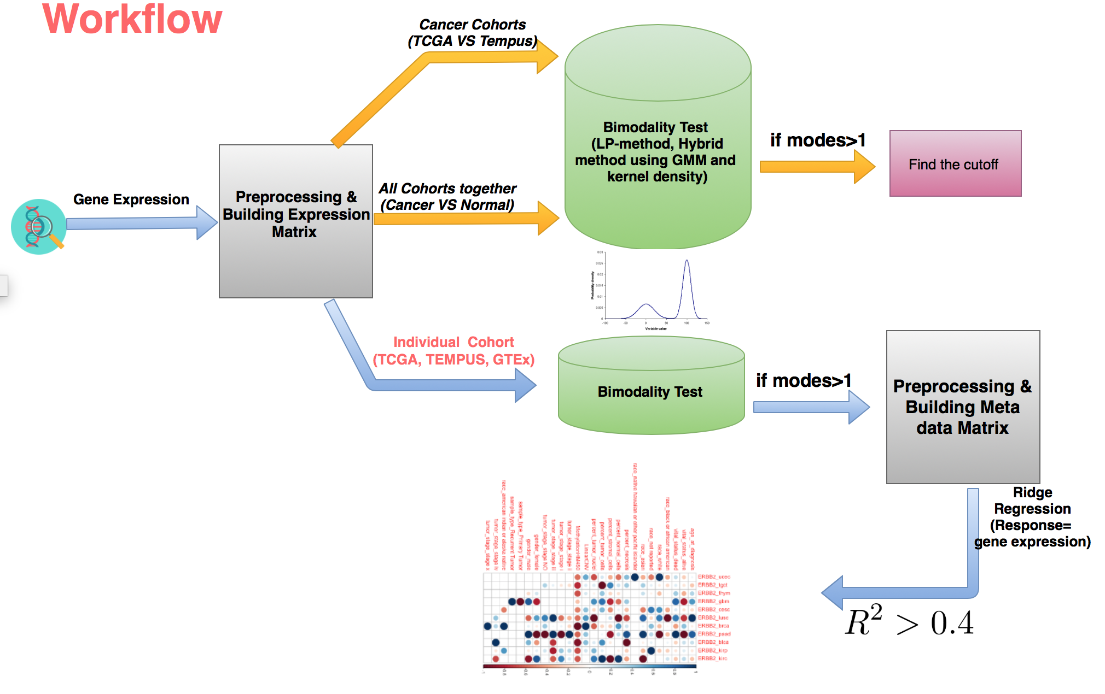

Slide 34
LP-Method for mode detection
Using both Gaussian Mixture Model (GMM) and Kernel Density methods to simultaneously fit the modes
Returns actual mode(s) and 95% interval
Extremely fast
Sensitive to outliers
Mukhopadhyay, Subhadeep. "Large-scale mode identification and data-driven sciences." Electronic Journal of Statistics 11.1 (2017): 215-240.

Slide 35
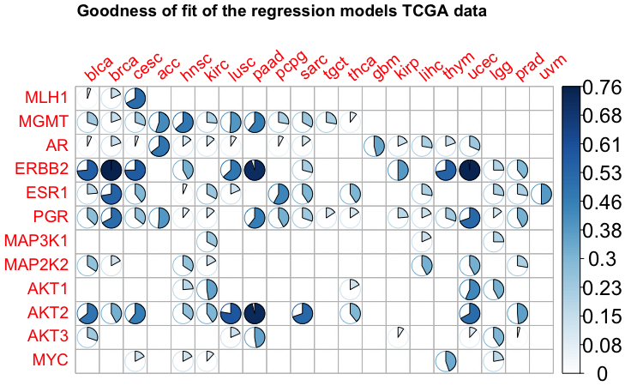
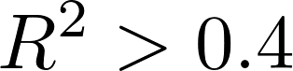
Ridge Regression (On TCGA)
Response (Y):
Gene expression vector
Predictors (X):
32 features extract from meta-data
Filter those models that has

Slide 36
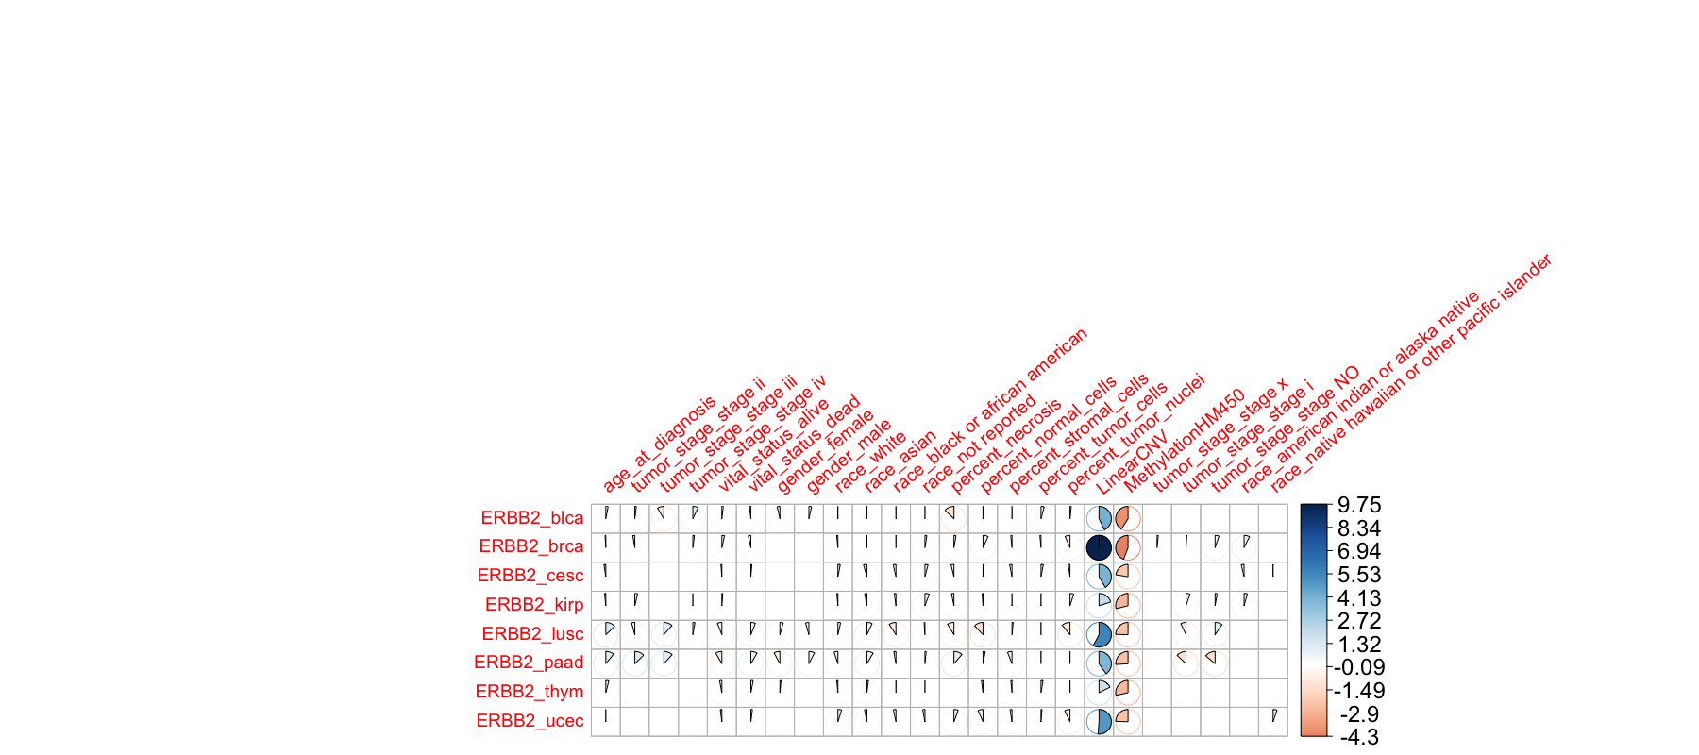
Interpret Result of The Model For ERBB2
Correlation plot for cancer types with
Non-zero coefficient of the regression model, represents the correlation between that features and gene expression.

Slide 37
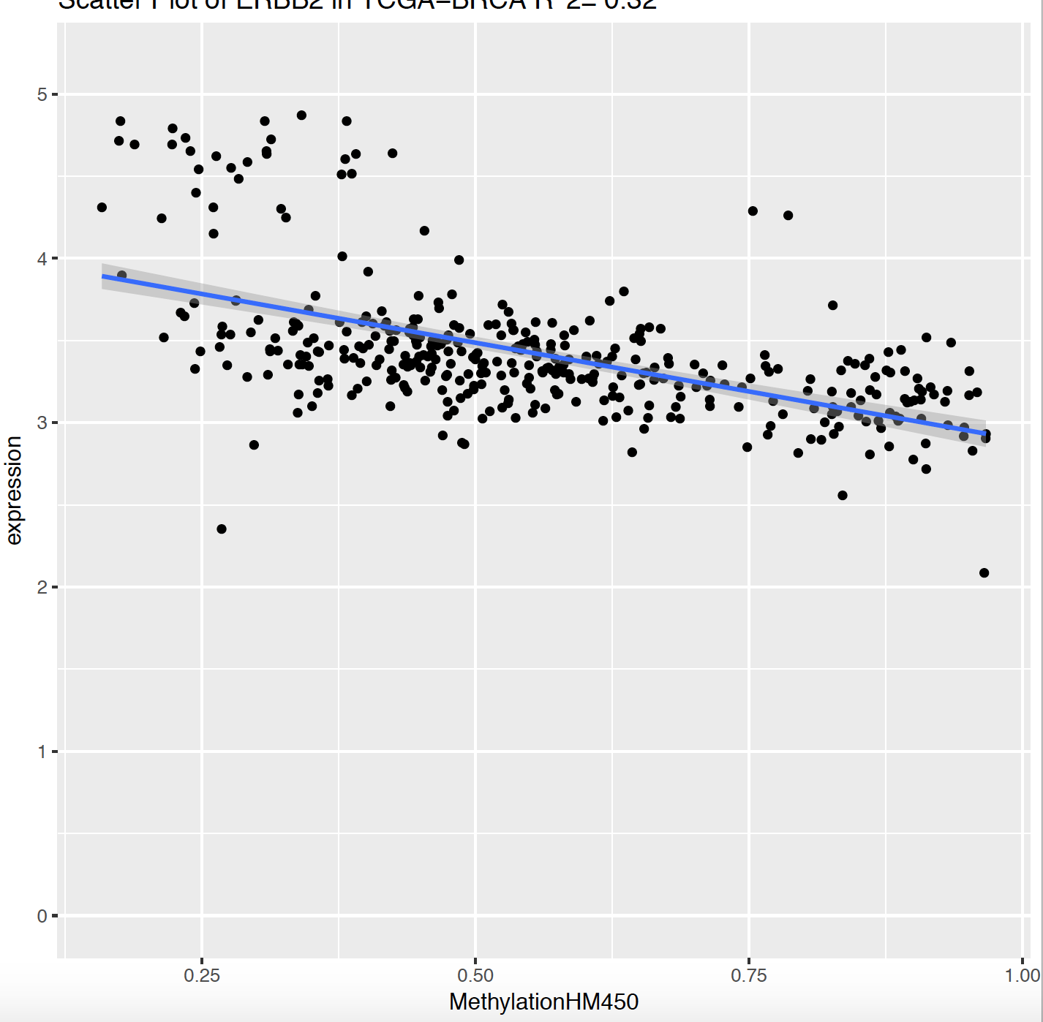
ERBB2 in Breast Cancer
Expression
Methylation
Methylation
CNV
Expression
Linear CNV
Expression

Slide 38
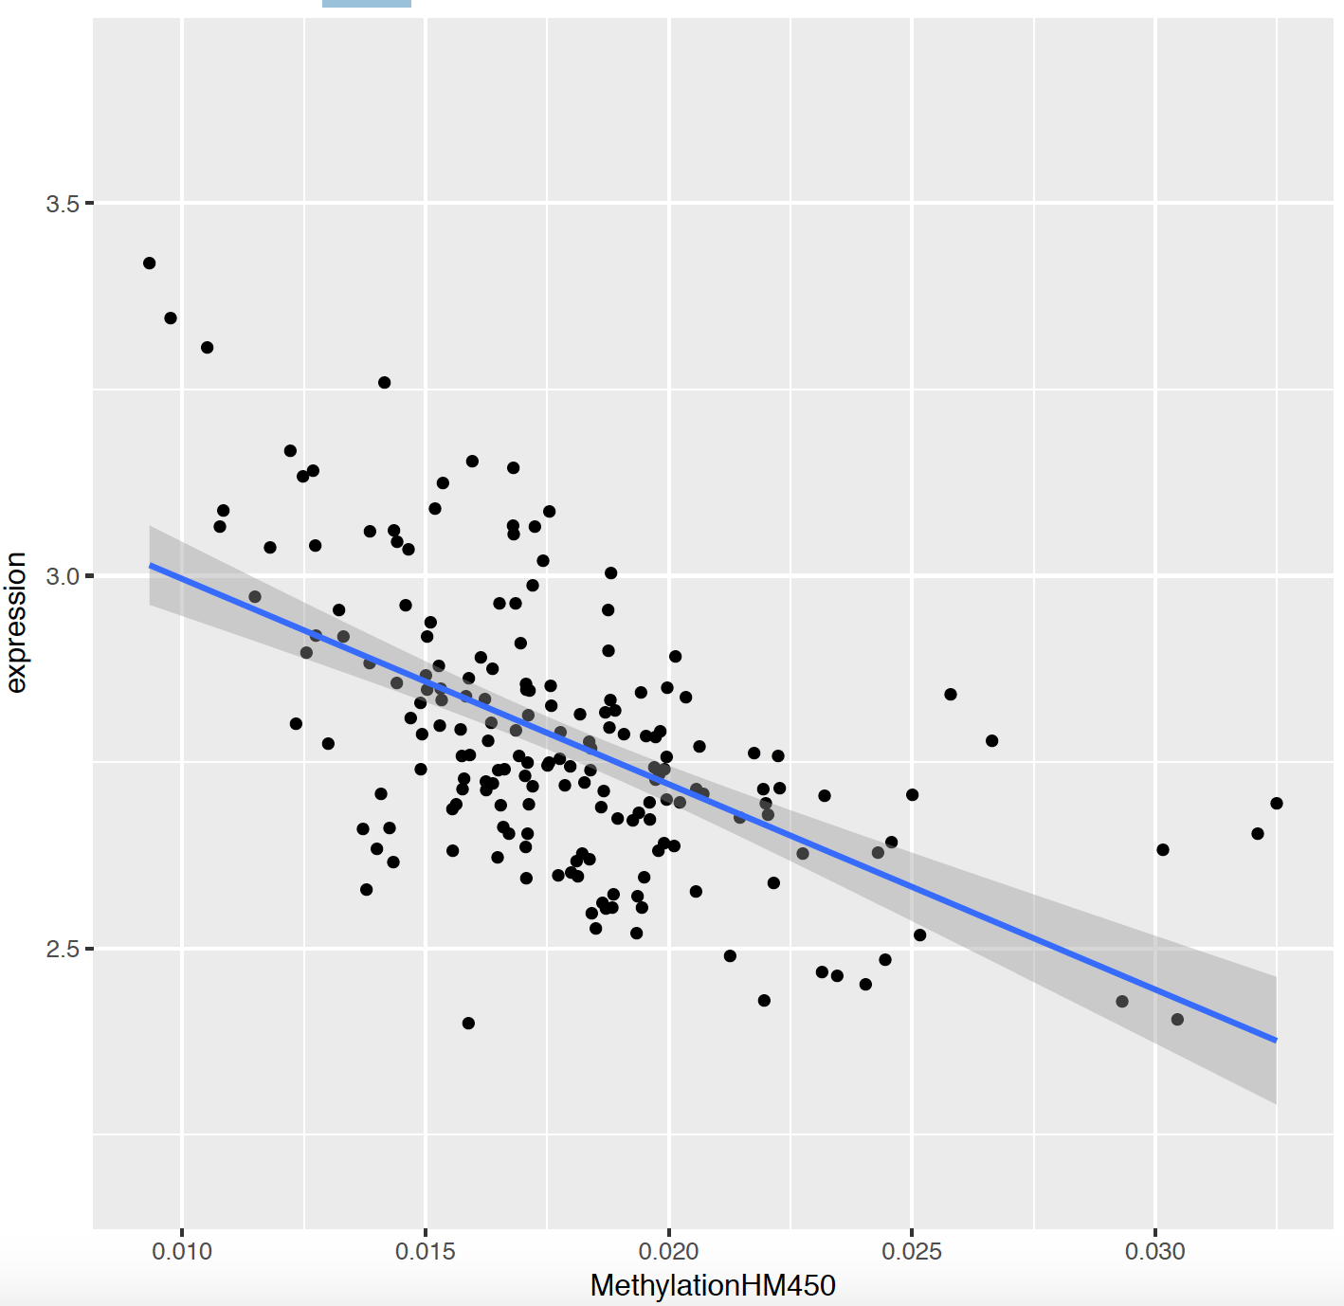
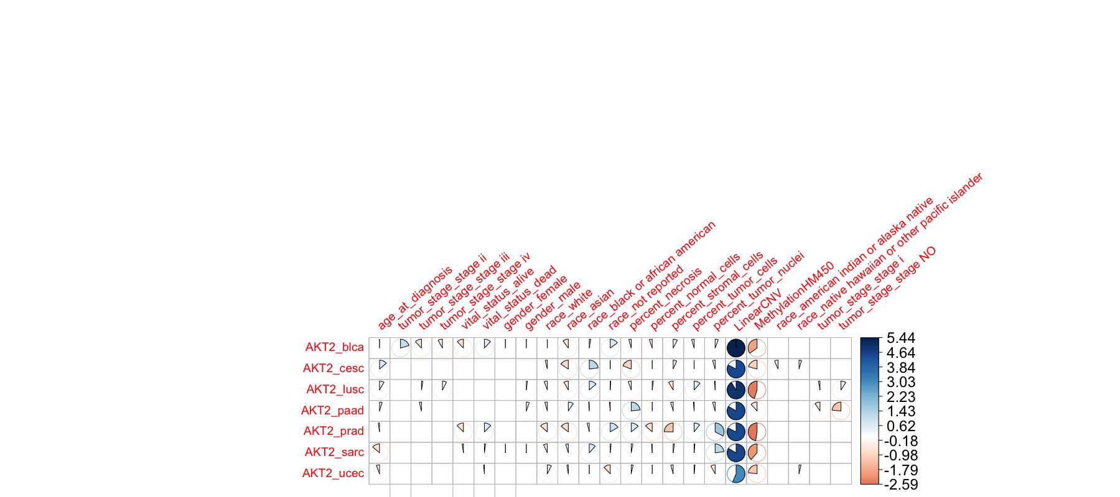
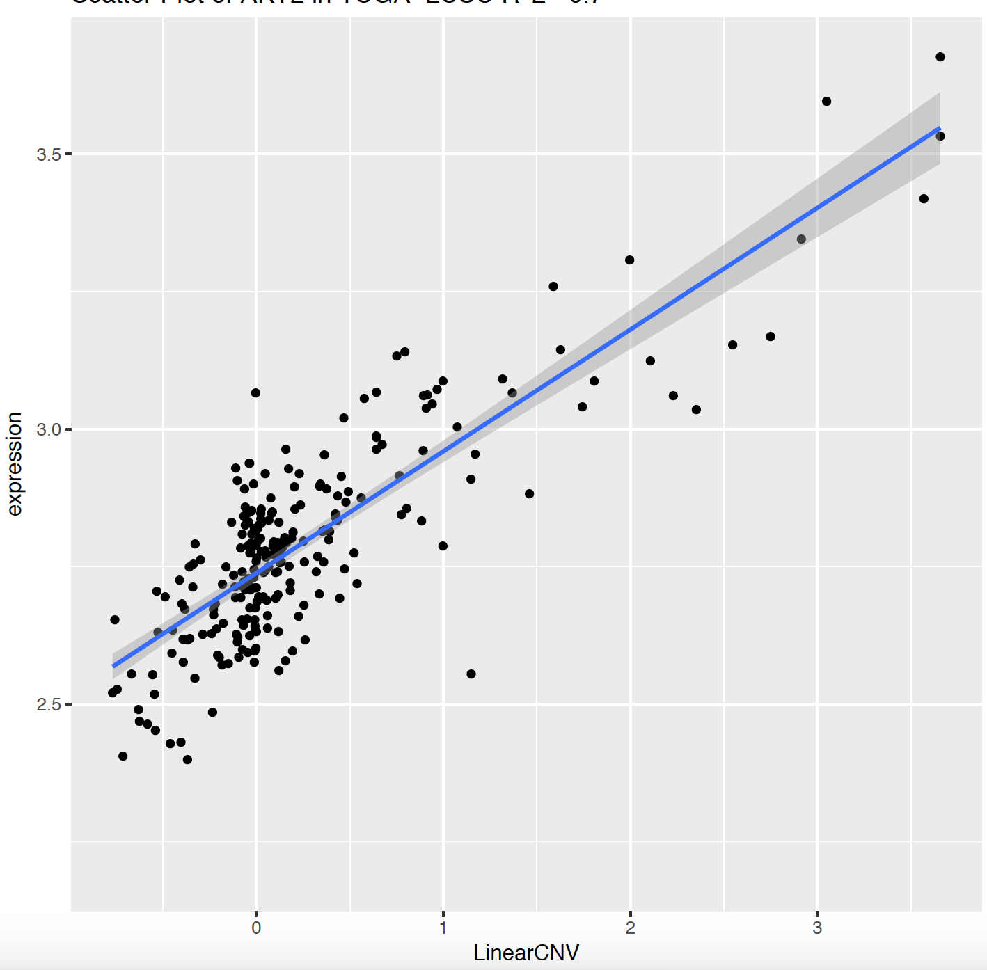
Result of AKT2 Model
Expression
Methylation
Expression
CNV

Slide 39
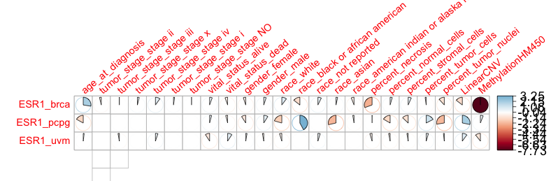
Result of ESR1 Model

Slide 40
Conclusion
Expression data is complex
An expression of a gene from a population can have a high or low variation which can be caused by different meta-data
This pipeline performs better for those genes that have a high variation
Multivariable models may help detect biological and molecular effects that result in bimodal gene expression distributions
These models can help improve over/under expression calls

Slide 41
Improving Result
How can we add pathway data into a model?
How about clinical data?
Performing more statistical analysis for each gene across different cancer types and try to interpret changes of the correlation and cluster them into meaningful biological groups
Is there any relationship between coefficient of oncogenes, tumor suppressor, housekeeping, Chromatin Accessibility , etc genes?

